Slide 1
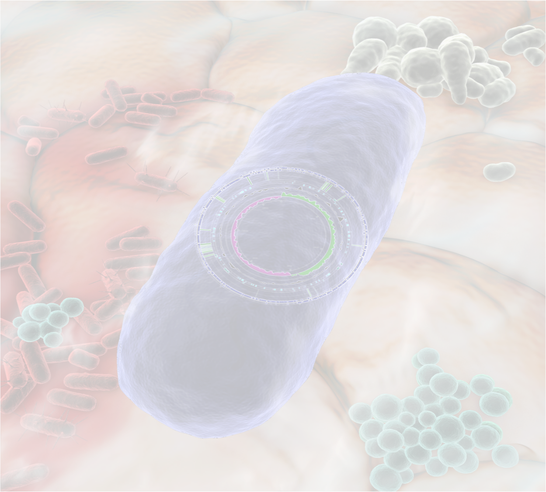


Bioinformatics and the human microbiome: working in the valley of multidisciplinary studies.
Greg Gloor
Biochemistry
Shulich School of Medicine and Dentistry

Slide 2
My work
I develop and implement novel approaches to characterizing microbiomes using high throughput sequencing.
Mainly computational, but also wet-lab and sequencing
My work is very collaborative
My students work with collaborators to design, conduct and analyze experiments

Slide 3
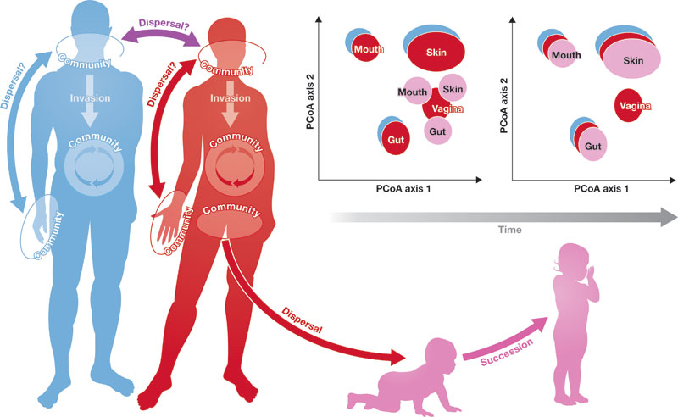
Human Microbiome
We are a supercommunity with both human ≈ bacterial cells
We need each other

Slide 4
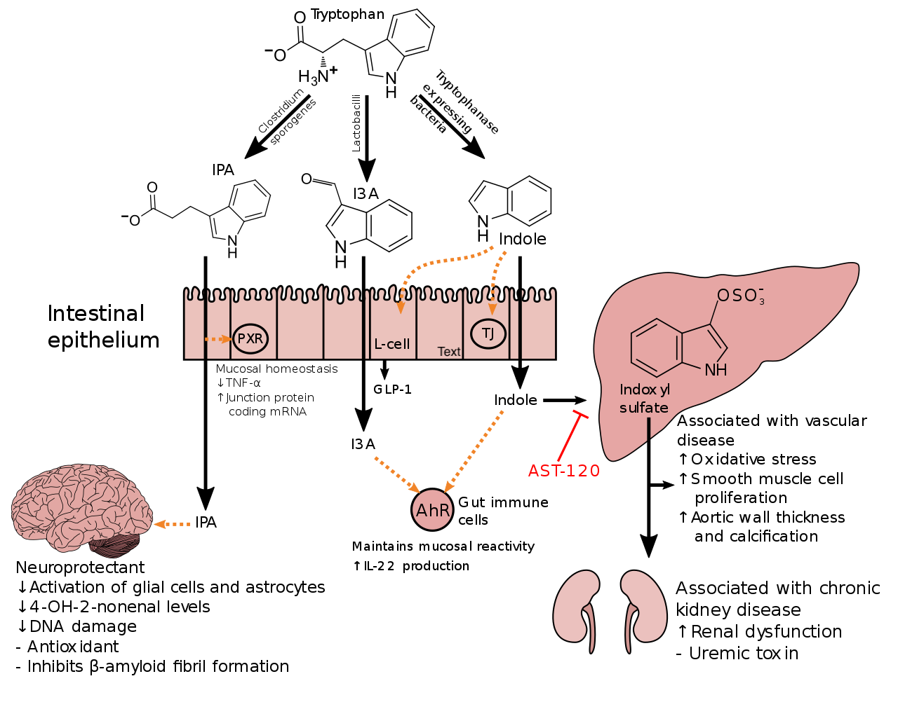
We co-operate with them
Notes:
Indole is produced from tryptophan by bacteria that express tryptophanase.[41] Clostridium sporogenes metabolizes tryptophan into indole and subsequently 3-indolepropionic acid (IPA),[42] a highly potent neuroprotective antioxidant that scavenges hydroxyl radicals.[41][43][44] IPA binds to the pregnane X receptor (PXR) in intestinal cells, thereby facilitating mucosal homeostasis and barrier function.[41] Following absorption from the intestine and distribution to the brain, IPA confers a neuroprotective effect against cerebral ischemia and Alzheimer’s disease.[41] Lactobacillus species metabolize tryptophan into indole-3-aldehyde (I3A) which acts on the aryl hydrocarbon receptor (AhR) in intestinal immune cells, in turn increasing interleukin-22 (IL-22) production.[41] Indole itself triggers the secretion of glucagon-like peptide-1 (GLP-1) in intestinal L cells and acts as a ligand for AhR.[41] Indole can also be metabolized by the liver into indoxyl sulfate, a compound that is toxic in high concentrations and associated with vascular disease and renal dysfunction.[41] AST-120 (activated charcoal), an intestinal sorbent that is taken by mouth, adsorbs indole, in turn decreasing the concentration of indoxyl sulfate in blood plasma.[41]

Slide 5
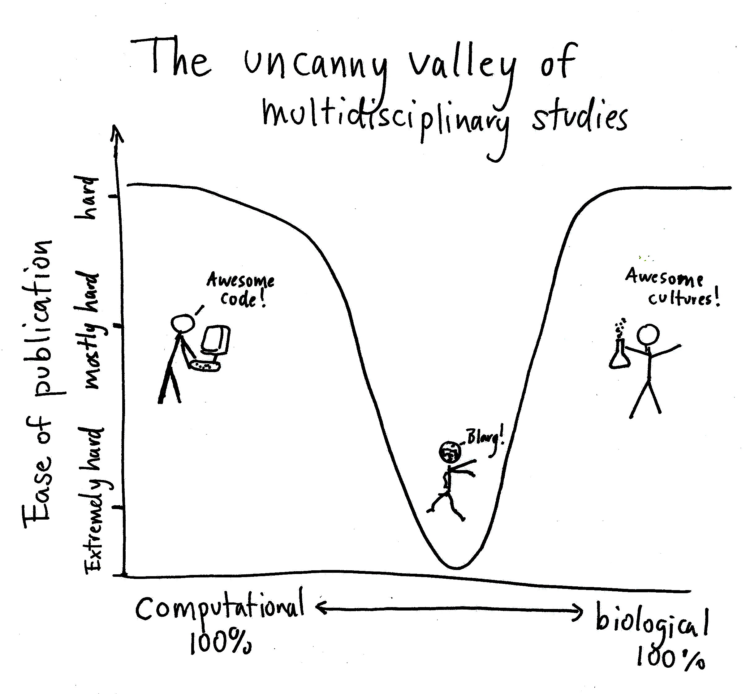
Every study is multi-disciplinary
Clinician/Biomedical researcher has question, collects samples, metadata
Trainee isolates DNA/RNA/metabolites/genomics
Data is collected
Computational biologist/Data scientist analyzes the data
Write the paper
Publish!
jasonya.com/wp/the-uncanny-valley-of-multidisciplinary-studies/

Slide 6
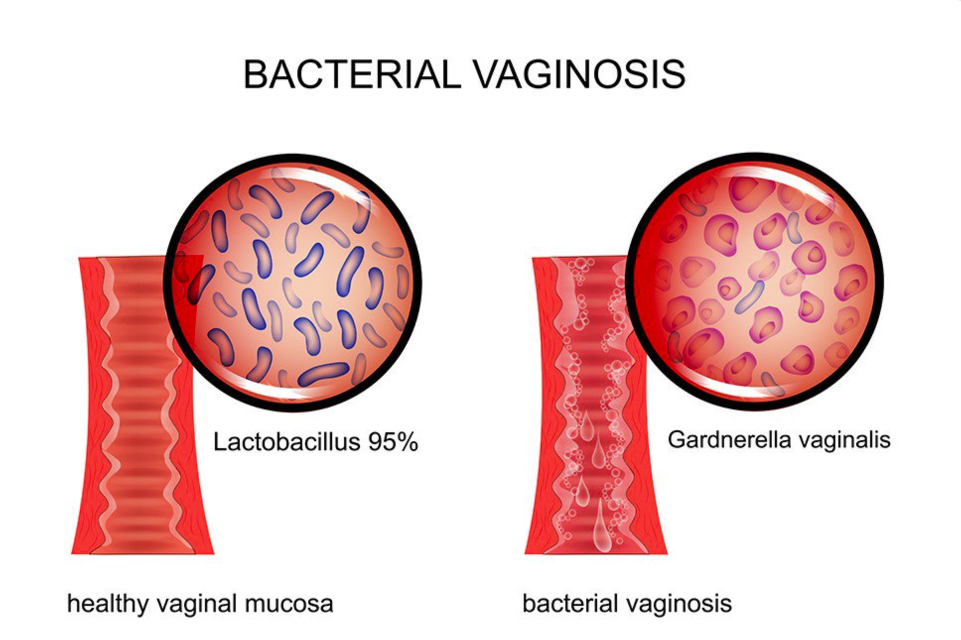
Bacterial vaginosis
Most common reason for women of childbearing age to visit family physician
Associated with increased risk
Contracting bacterial and viral STDs
Preterm birth
Overgrowth of mixed set of anaerobic bacteria that displace Lactobacillus spp.
Easy to treat, difficult to cure
It is a dysbiosis, not an infection
Dogma is that primary pathogen is Garderella vaginalis
We set out to test this

Slide 7
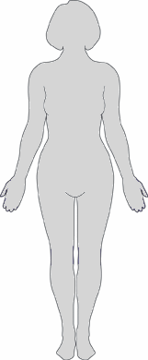
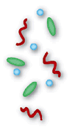
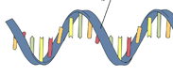
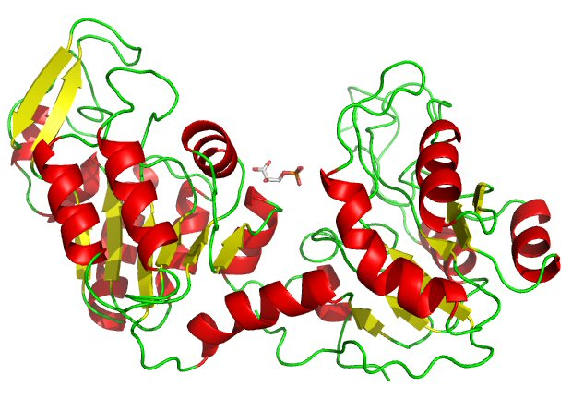
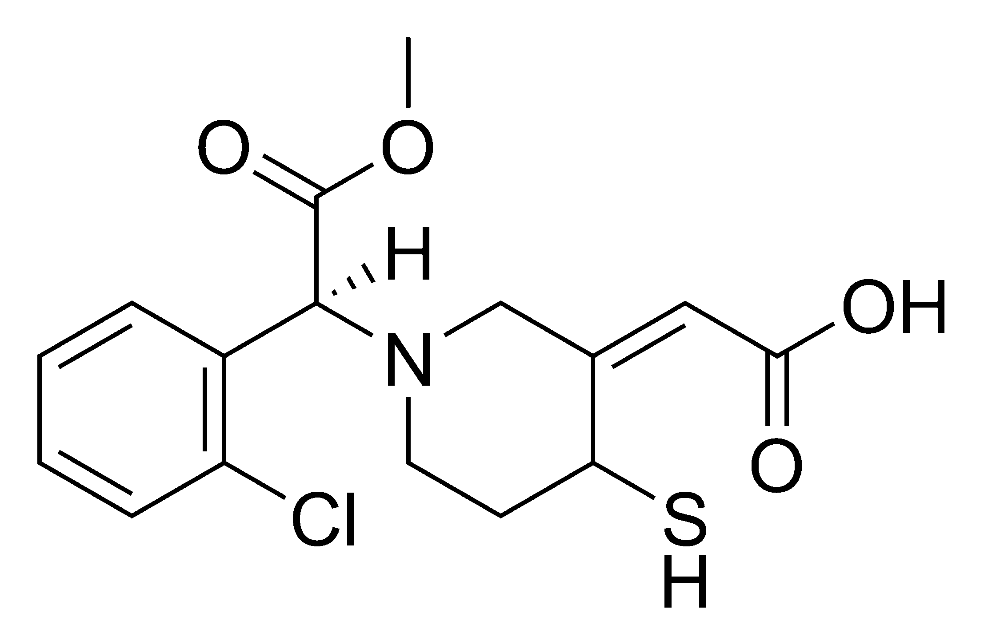

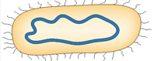
Microbes and the “meta-organism”
Microbiome
Targeted amplicon seq (e.g. 16S)
High-throughput sequencing
Mass spectroscopy
Metagenomics
Metatranscriptomics
Proteomics
Metabolomics
DNA
mRNA
Proteins
Metabolites

Slide 8
Meta-transcriptomics
Bacterial mRNAseq reads
Reference genome CDS
Assembly of novel ORFs
90% sequence ID clustering: refseqs
Organism-specific
Read mapping
Group by SEED subsys4
Function

Slide 9
Function trumps taxonomy

Slide 10
Metabolic biomarkers
*MacMillan et al. (2015) Sci. Rep

Slide 11
Summary
Sequencing data are inherently compositional and a CoDa framework and provides a robust analysis of variance (YDK)
Functions are conserved regardless of the community members
Ecosystem is more important than any organism
Community members can cooperate
Using two high-resolution methods (metabolome, and metaRNAseq) provides a more holistic view of a complex system
Agreements (H v BV: amines, succinate), different resolution
Correspondence between DNA, RNA, small molecules
Relationship status: it’s complicated but some successes

Slide 12







Acknowledgements
Jean Macklaim
Victoria Family Medical Centre
Dr. Jo-Anne Hammond
Holly Inges
Jerry Wu
Ruth Grace Wong
Agriculture Canada
Mark Sumurah
U. Guelph/Queens U.
Emma Allen-Vercoe
Elaine Petrof
Gregor Reid
Amy McMillan
mmacklai.github.io
ggloor.github.io
Notes:
With that, I’ll thank the people on this slide and thank you for listening

